Slide 1
Image Classification Convolutional Neural Networks
Nairobi AI Community.
Presented by Regan Muthomi

Slide 2

Introduction
Who is Regan?
A self taught developer, school taught Economist.
Data Science instructor at Africa Data School.
Freelance Developer
What he loves (Besides coding)
Playing football.
Watching MMA, Football, Rugby.
Twitter: @regan_codes | LinkedIn: Regan Muthomi

Slide 3
Computer Vision
We cannot talk about Convolutional Neural Nets and not talk about computer vision.
What is computer Vision? Computer vision is a field of artificial intelligence (AI) that enables computers and systems to derive meaningful information from digital images, videos and other visual inputs — and take actions or make recommendations based on that information. (IBM)
It enables computers to see, observe and understand visual data.

Slide 4
Applications of Computer Vision
Self Driving Cars.
Facial Detection & Recognition.
Medicine and Biology.

Slide 5
What a Computer Sees
To a computer, a digital image is just a bunch of numbers (0-255) in a matrix.
Each number represents a single pixel in an image.
In a grayscale images each pixel contains a single number denoting the intensity of that pixel.
In RGB images, a pixel has 3 numbers denoting the Red, Green, Blue color channels.

Slide 6
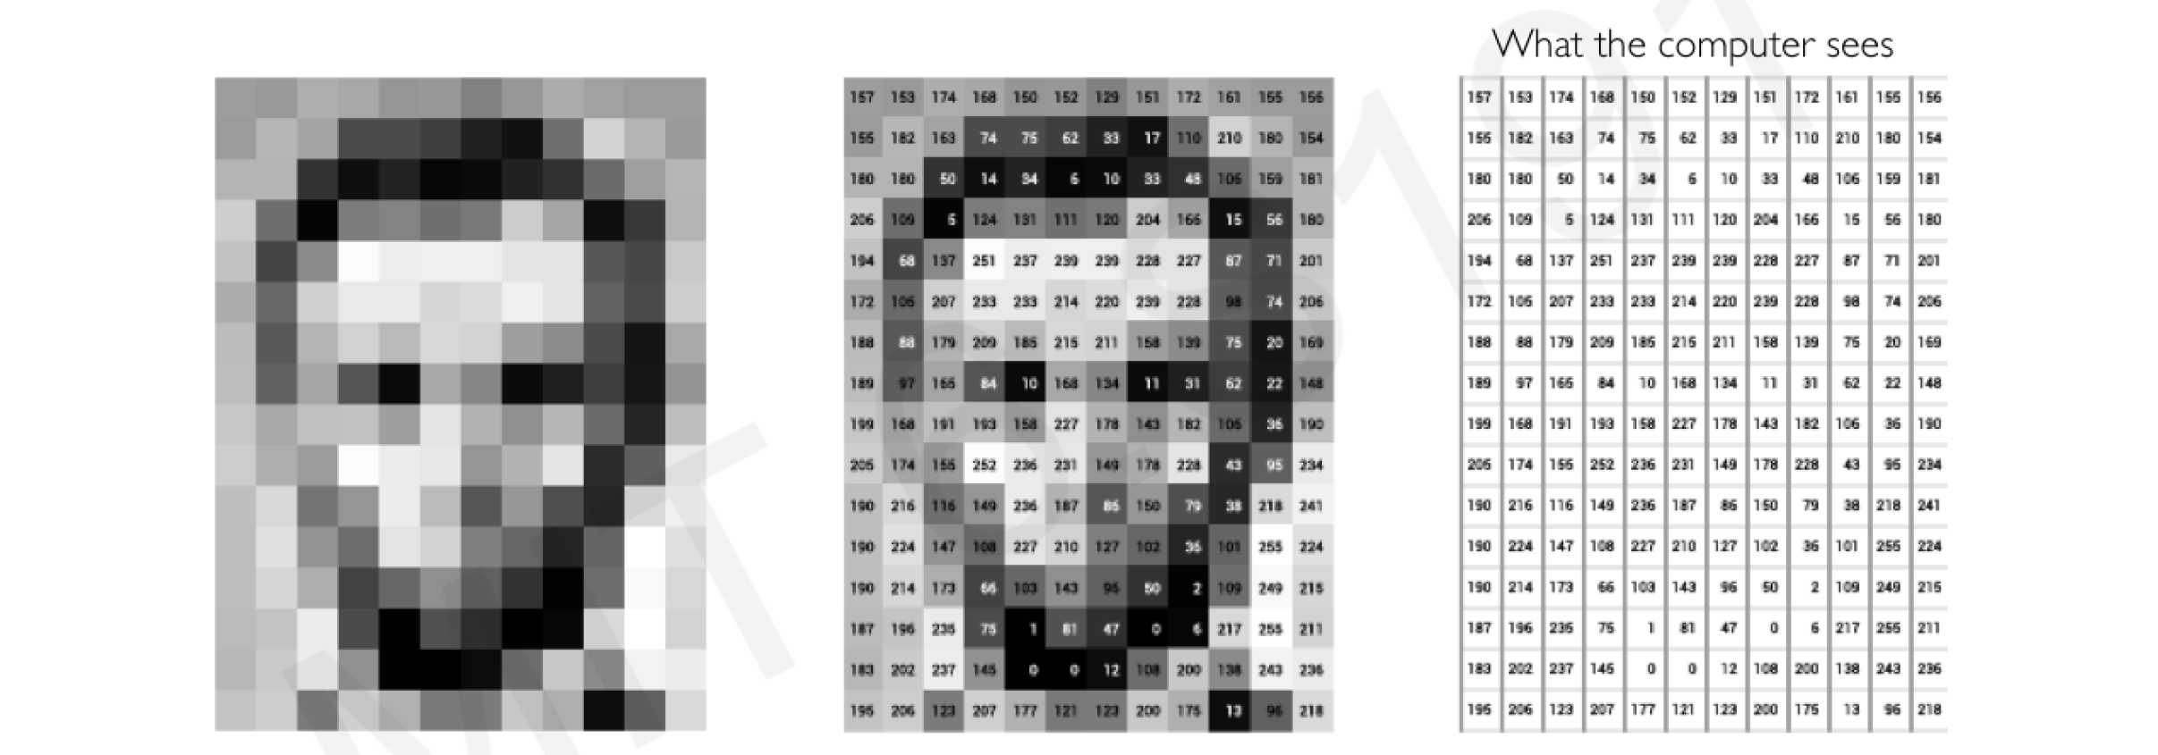
…

Slide 7

Convolutional Neural Networks (CNN)
At the heart of deep learning success in computer vision, is a kind of network called Convolutional Neural Net/ConvNet.
The CNN works by extracting features from images and then feeding them through a fully connected neural network.

Slide 8
Layers of CNN
Convolution Layer.
Non linearity.
Pooling Layer.
Flattening Layer.
Fully Connected Layer.

Slide 9
Convolution Layer.
The convolution Layer is where feature detection and extraction happens.
This is a dot product between two matrices, where one matrix is the set of learnable parameters otherwise known as a filter, and the other matrix is the restricted portion of the receptive field on the input image.
The kernel shifts every time performing a matrix multiplication between itself and the portion of the input image over which its hovering. These shifts are called Strides.
The kernel moves to the right with the specified stride value till it parses the entire width. Moving on it hops down to the beginning (left) of the image with the same stride value and repeats the process until the entire image is traversed.
The output of this matrix multiplication is what I called a convolved feature or feature map

Slide 10
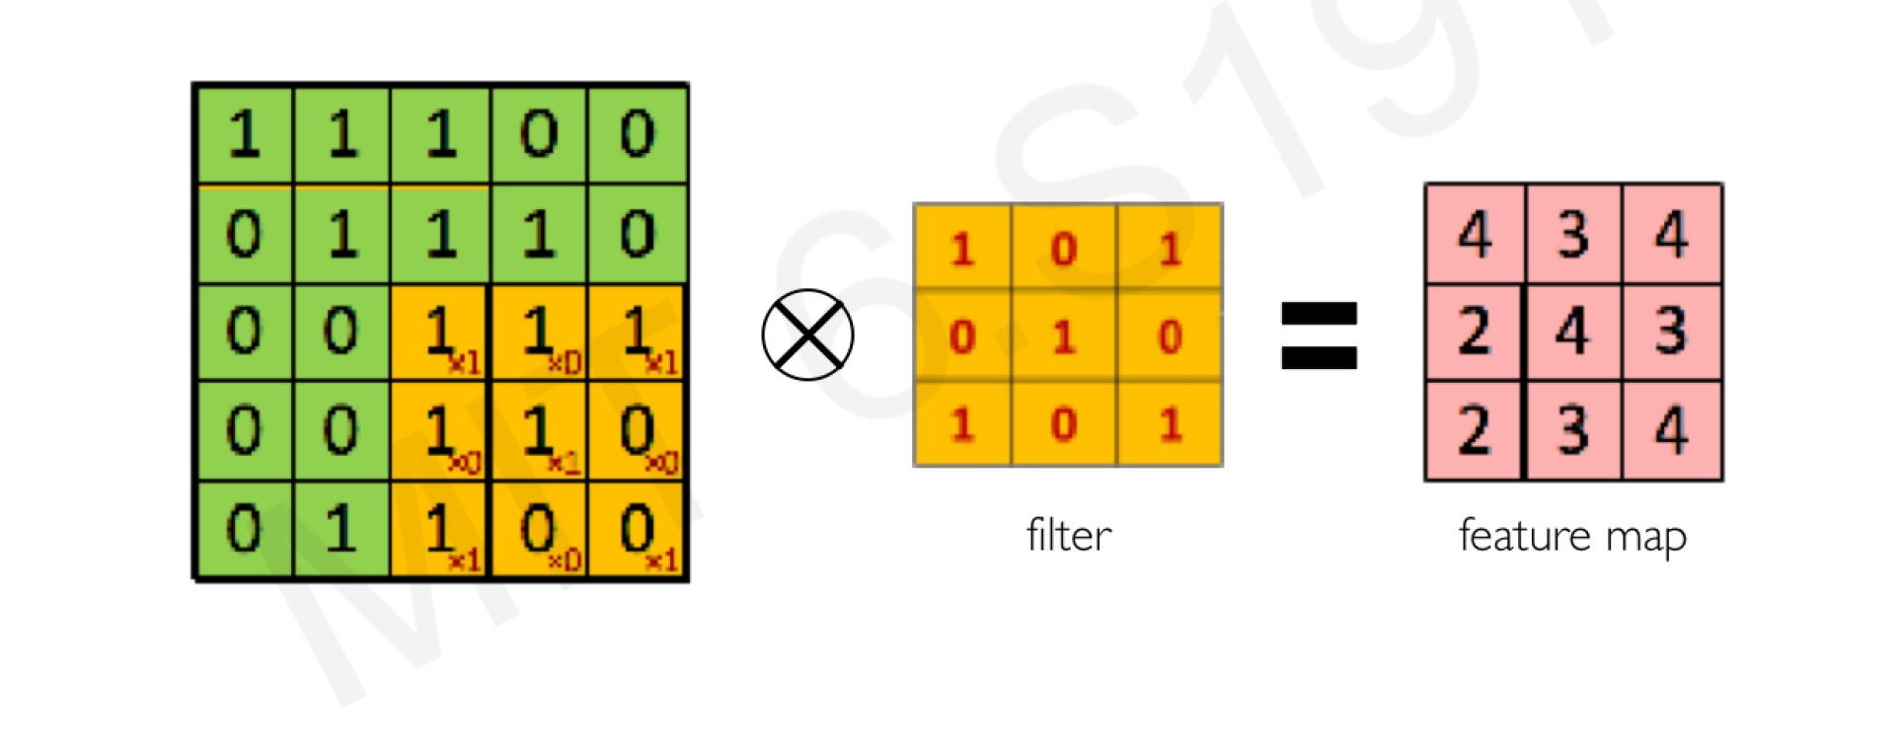
…convolution layer
Convolution Operation.

Slide 11
…convolution layer
In the case of images with multiple channels e.g. RGB, the kernel has the same depth as the that of the input image.
Matrix multiplication is performed between Kn and In stacks ([K1, I1]; [K2, I2]; [K3, I3]) and all results are summed with the bias to give a squashed one depth channel convoluted feature output.

Slide 12
…

Slide 13
… Convolution layer
The depth of a filter in a CNN must match the depth of the input image. The number of color channels in the filter must remain the same as the input image.
Different Conv2D filters are created for each of the three channels for a color image.
Filters for each layer are randomly initialized based on either Normal or Gaussian distribution.
Initial layers of a convolutional network extract low-level features from the image, so use fewer filters. As we build further deeper layers, we increase the number of filters to twice or thrice the size of the filter of the previous layer.
Filters of the deeper layers learn more features but are computationally very intensive.

Slide 14
…Convolution Layer
The objective of the convolution operation is to extract the high level features from the input images.
CNN need not to be restricted to only one layer.
The first layer is responsible for capturing the low level features such as color gradient orientation, edges etc.
With added layer, the architecture adapts to the high level features as well as giving us a network that has the understanding of the dataset.

Slide 15
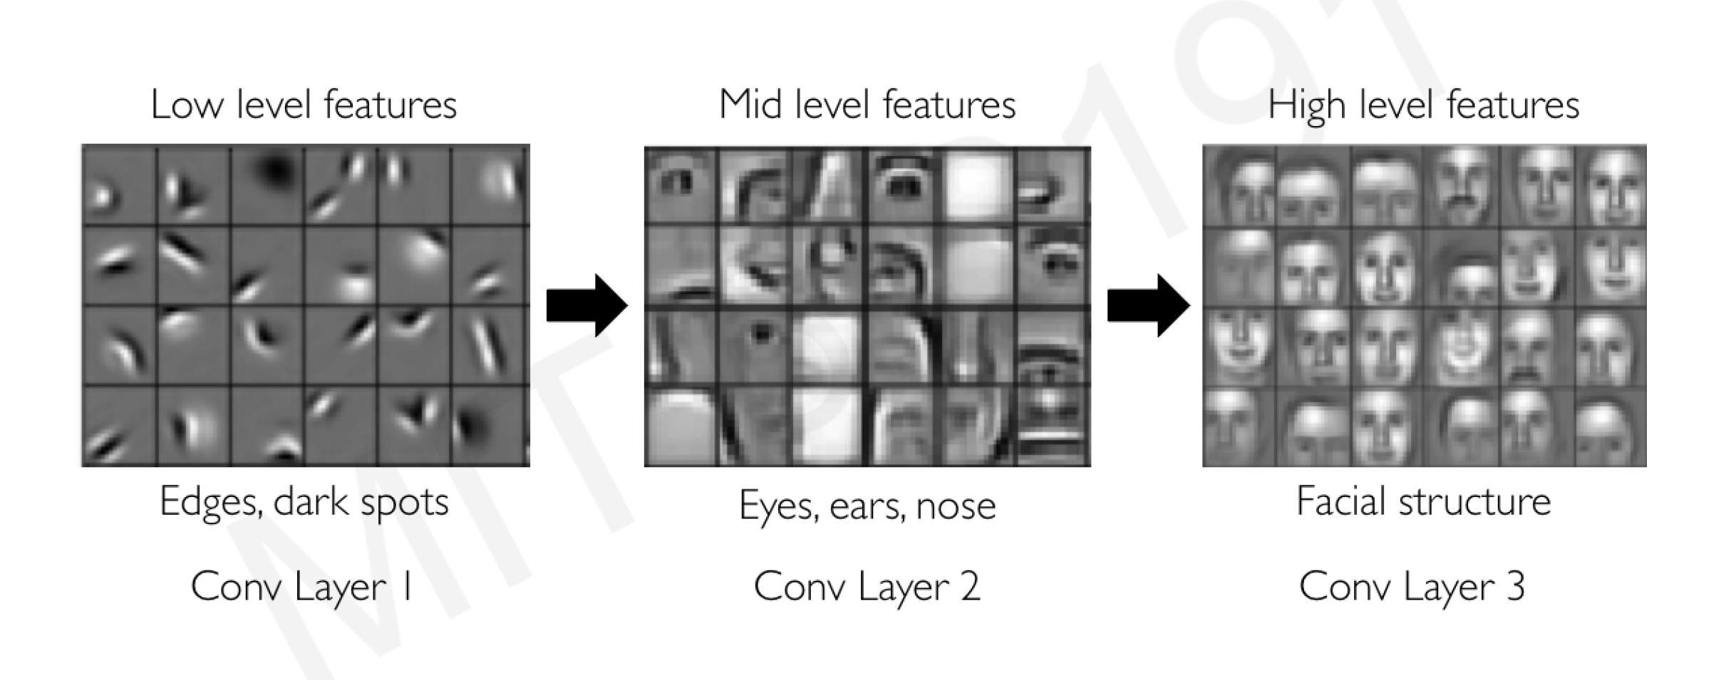
… Convolution layer

Slide 16
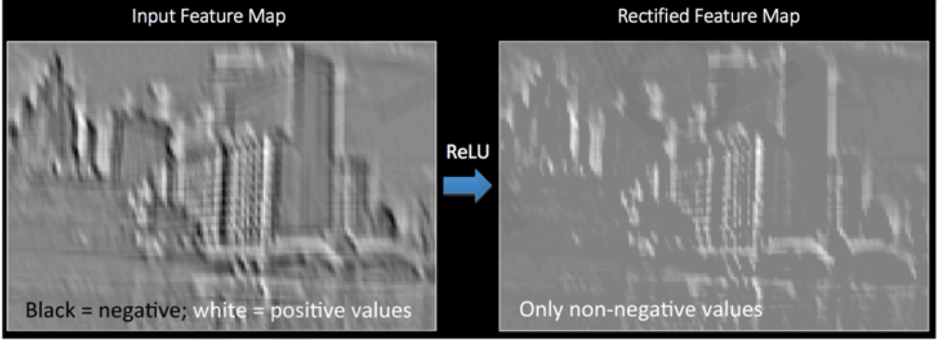
Non Linearity
After every convolution operation, we apply a non-linear operation.
We are going to use a fast and efficient activation function called Rectified Linear Unit for this.
ReLU works by replacing all negative values in each pixel with zero.

Slide 17
Pooling
Pooling reduces the size of the convolved feature hence reducing the computational power required to process the data through dimensionality reduction.
Its also useful in extracting only the dominant features in the images hence reducing overfitting which may occur if the CNN is given a lot of information which is not relevant in classifying the image.
In pooling we also make use of a kernel and a specified stride value.

Slide 18
…Pooling
There are two type in pooling in CNN: Max Pooling and Average Pooling.
Max pooling returns the maximum value from the portion of the image covered by the Kernel.
Average pooling on the other hand returns the average of the portion of the image covered by the Kernel.
Max pooling also serves as a Noise Suppressant. It discards the noisy parts of the image as well as dimensionality reduction.
Average pooling only performs dimensionality reduction as a noise suppressing mechanism.
Therefore we can say that Max pooling performs better than average pooling.
The output of pooling is now called a pooled feature map.

Slide 19
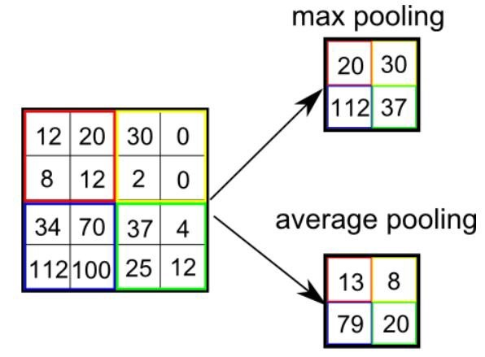
…pooling
If you want a CNN with more than one Convolutional Layer, repeat the steps above.
Increases the number of filters.

Slide 20
Flattening
Flattening involves transforming the pooled feature map into a single vector/array which now fed to the Neural Network for processing.

Slide 21
Fully connected Layer
The flattened output is fed to the feed forward neural network. Information is passed through the network and the error of prediction is calculated.
The error is the back propagated through the network to minimize the error and improve the prediction.
The fully connected layer after computations, outputs a vector of logits that is passed through an activation function that transforms the logits to probabilities for each class.
The class with the highest probability value becomes the predicted class.

Slide 22
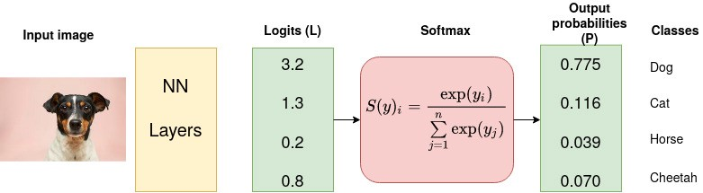
…

Slide 23
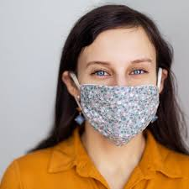
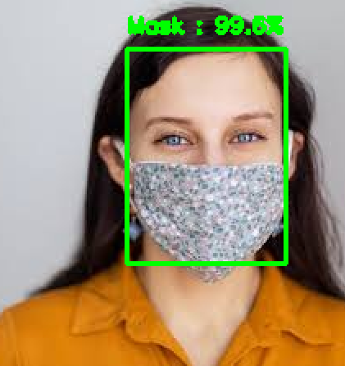
Face Mask Detector

Slide 24
End
Thank you

